Slide 1
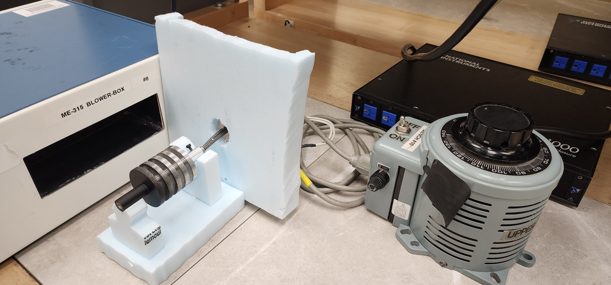
Annular Fin Efficiency vs Thickness Analysis
By: Jordan Dobstaff, Alexander Wiseman, Agathiya Tharun

Slide 2
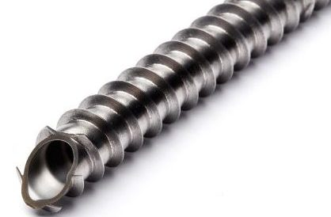
Introduction/Motive
Commonly used to dissipate heat from pipe flow
Not as common as other fin types; rectangular
Barely covered in class
Significant implications for research and design
What fin characteristics most contribute towards maximizing efficiency?
To what extent does varying fin thickness change fin efficiency?
(N.d.). Retrieved from https://durafintube.com/wp-content/uploads/2019/08/DURA-IT-EDGE-TENSION-WITH-CORRUGATION-FINNED-TUBE-e1565881831553.jpg

Slide 3
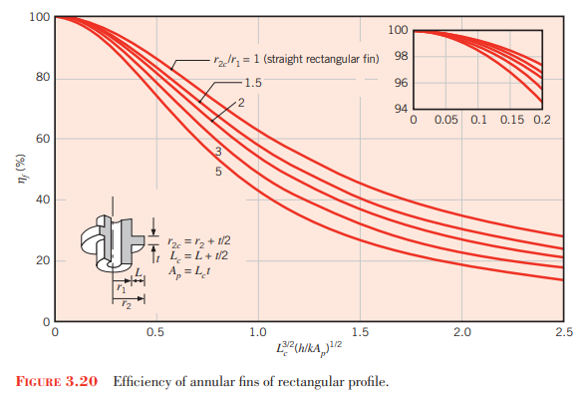
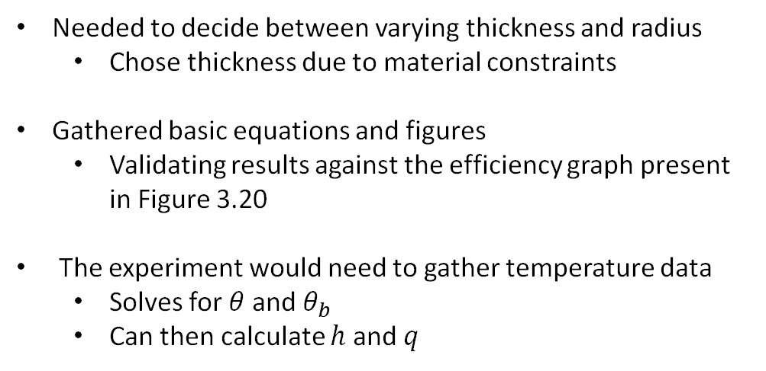
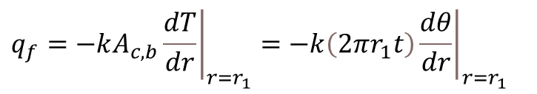
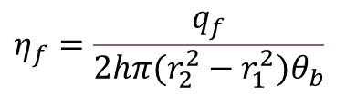
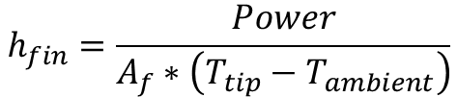
Theory
Needed to decide between varying thickness and radius
Chose thickness due to material constraints
Gathered basic equations and figures
Validating results against the efficiency graph present in Figure 3.20
The experiment would need to gather temperature data
Solves for $θ$ and $θ_{b}$
Can then calculate $h$ and $q$
$$η_{f}=\frac{q_{f}}{2hπ(r_{2}^{2}−r_{1}^{2})θ_{b}}$$
$$h_{fin}=\frac{Power}{A_{f}∗\left(T_{tip}−T_{ambient}\right)}$$
$$q_{f}=−kA_{c,b}{\left.\frac{​dT}{dr}\right|}_{r=r_{1}}=−k\left(2πr_{1}t\right){\left.\frac{​dθ}{dr}\right|}_{r=r_{1}}$$

Slide 4
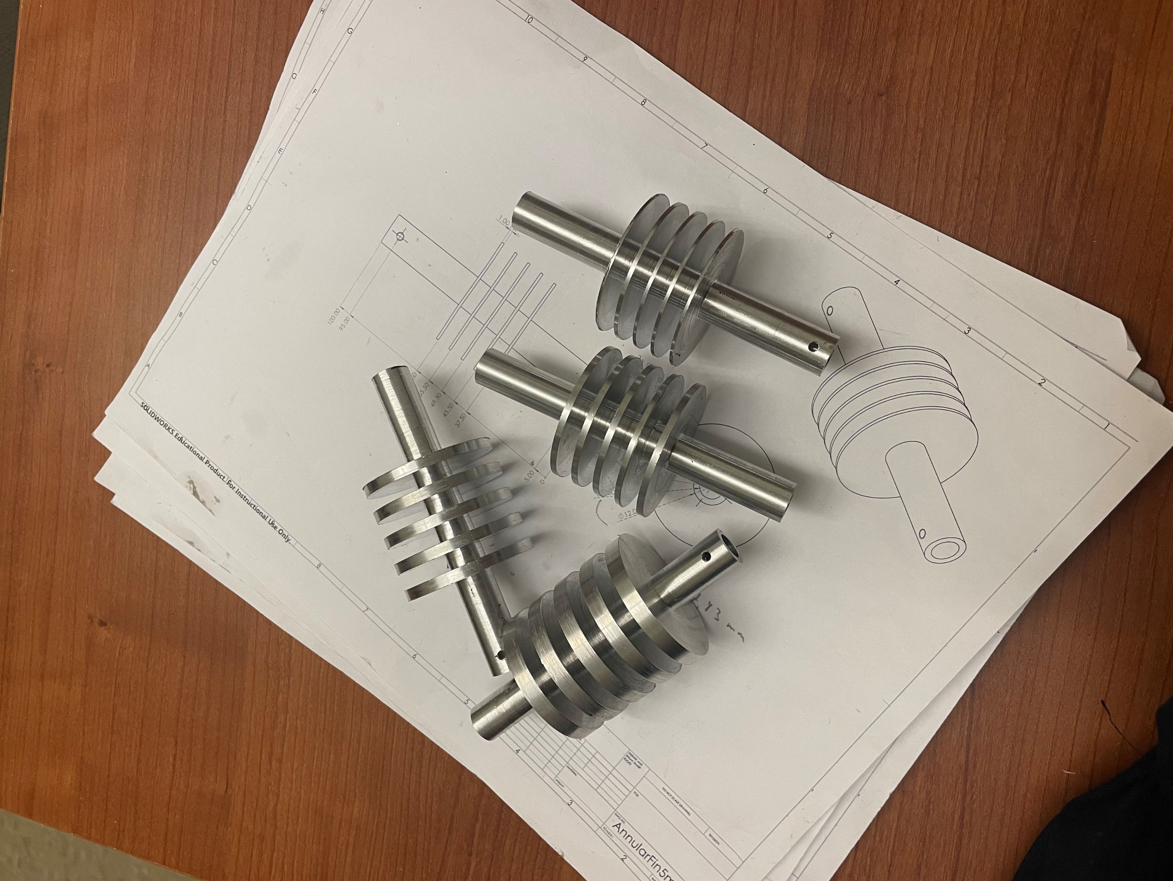
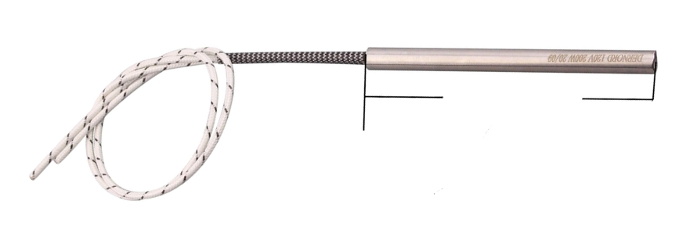
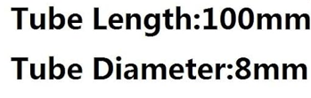
Procurement
Supplying heat:
Heating cartridge through the center of the fins simulates a heated fluid flow.
Set screws were purchased to keep the system intact
Sourcing fins:
Easier to machine on lathe and much cheaper than purchasing from online.
Sourced round aluminum stock from the scrap room
Inner diameter was machined to be a transition fit with the cartridge to minimize contact resistance

Slide 5
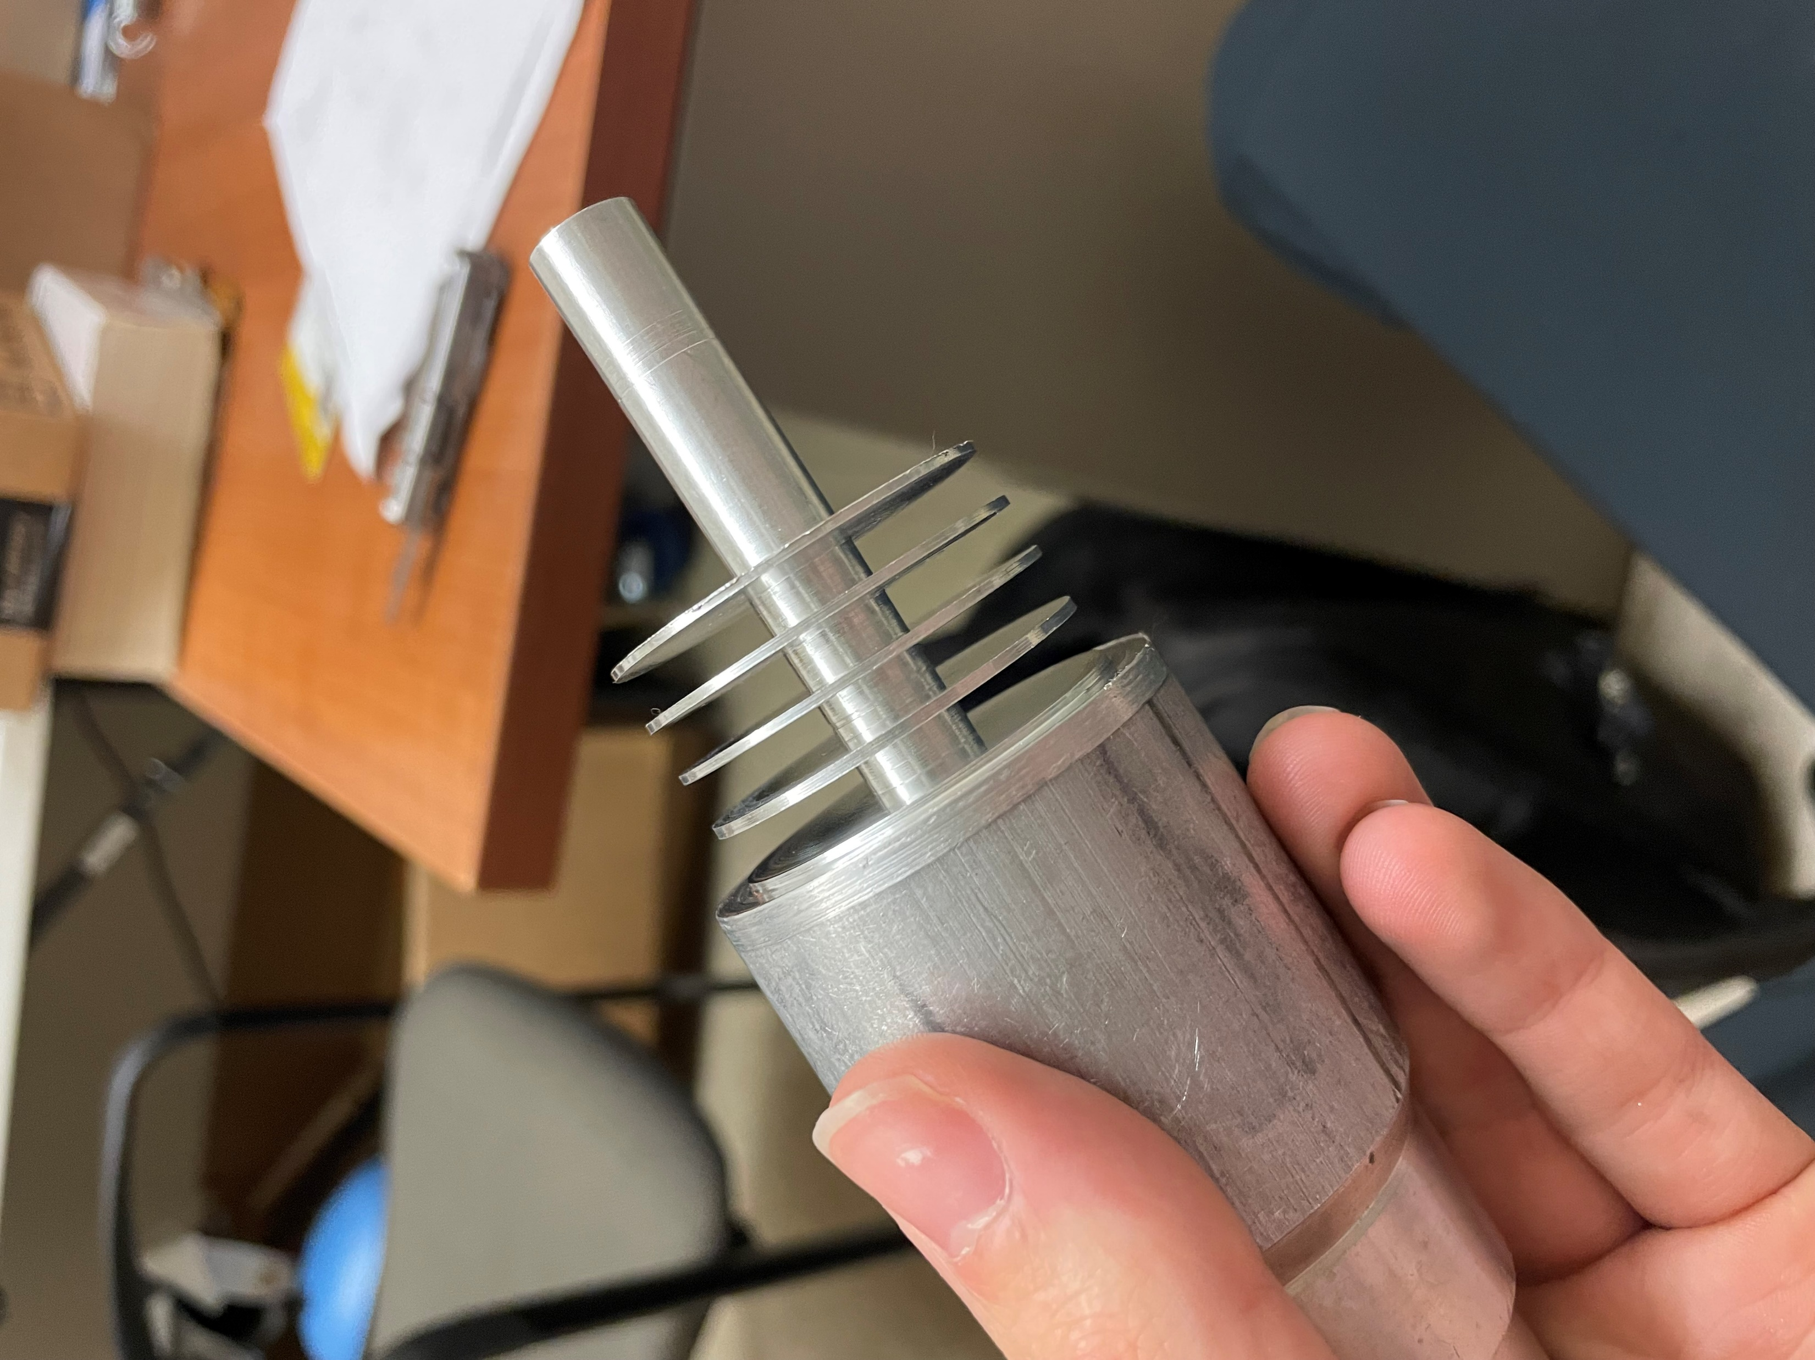
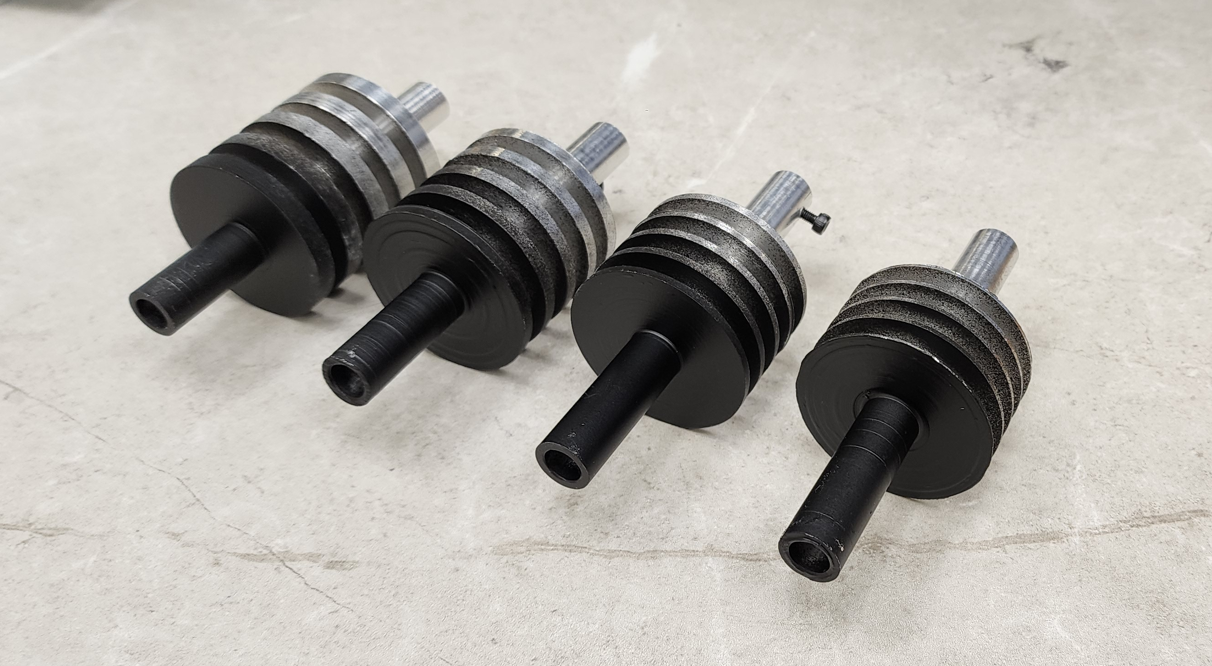
Procurement (cont.)
Thermal imaging:
Aluminum is too reflective for the camera.
Painted the fins matte black to fix this issue.

Slide 6
Experimental Overview
Unknown Variables:
Fin temperatures
Heat transfer coefficient
Efficiency
Known Variables:
Fin dimensions
Input power
Assumptions:
Each fin has the same temperature distribution
Negligible radiation
Negligible contact resistance
Input power is constant
1-D heat transfer

Slide 7
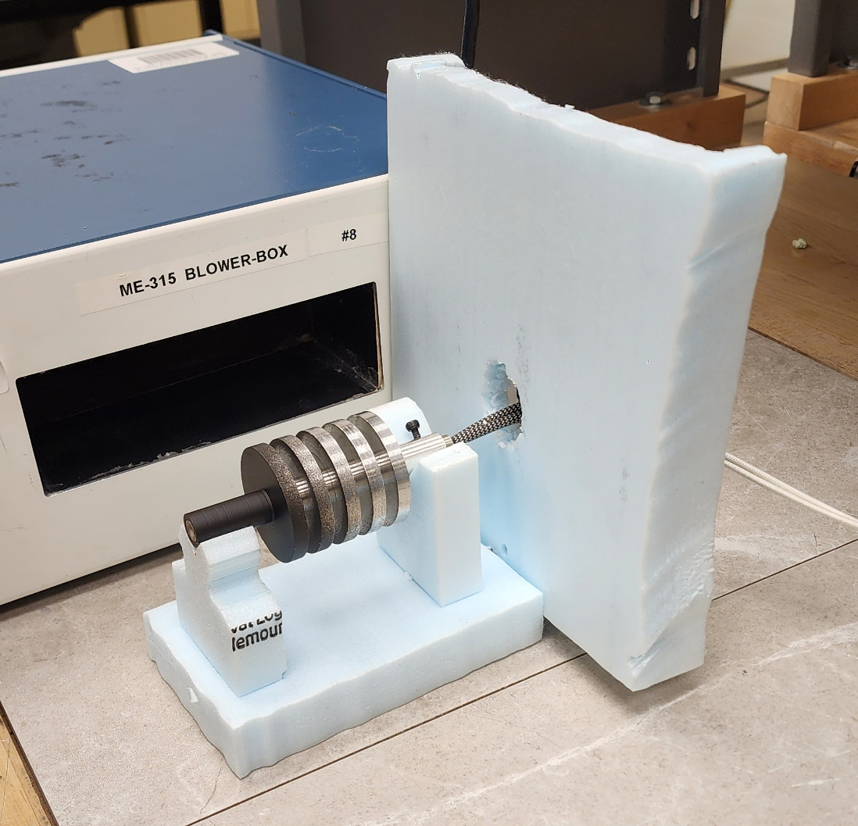
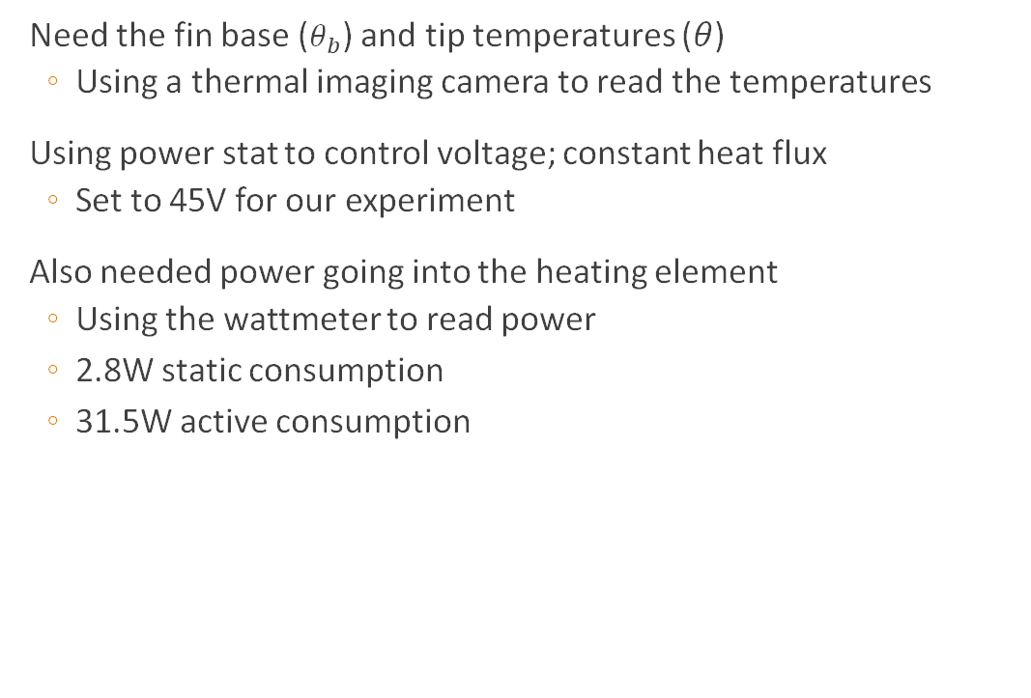
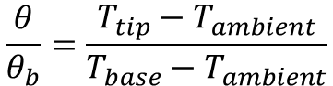
Methodology
Need the fin base ($θ_{b}$) and tip temperatures ($θ$)
Using a thermal imaging camera to read the temperatures
Using power stat to control voltage; constant heat flux
Set to 45V for our experiment
Also needed power going into the heating element
Using the wattmeter to read power
2.8W static consumption
31.5W active consumption
$$\frac{θ}{θ_{b}}=\frac{T_{tip}−T_{ambient}}{T_{base}−T_{ambient}}$$

Slide 8
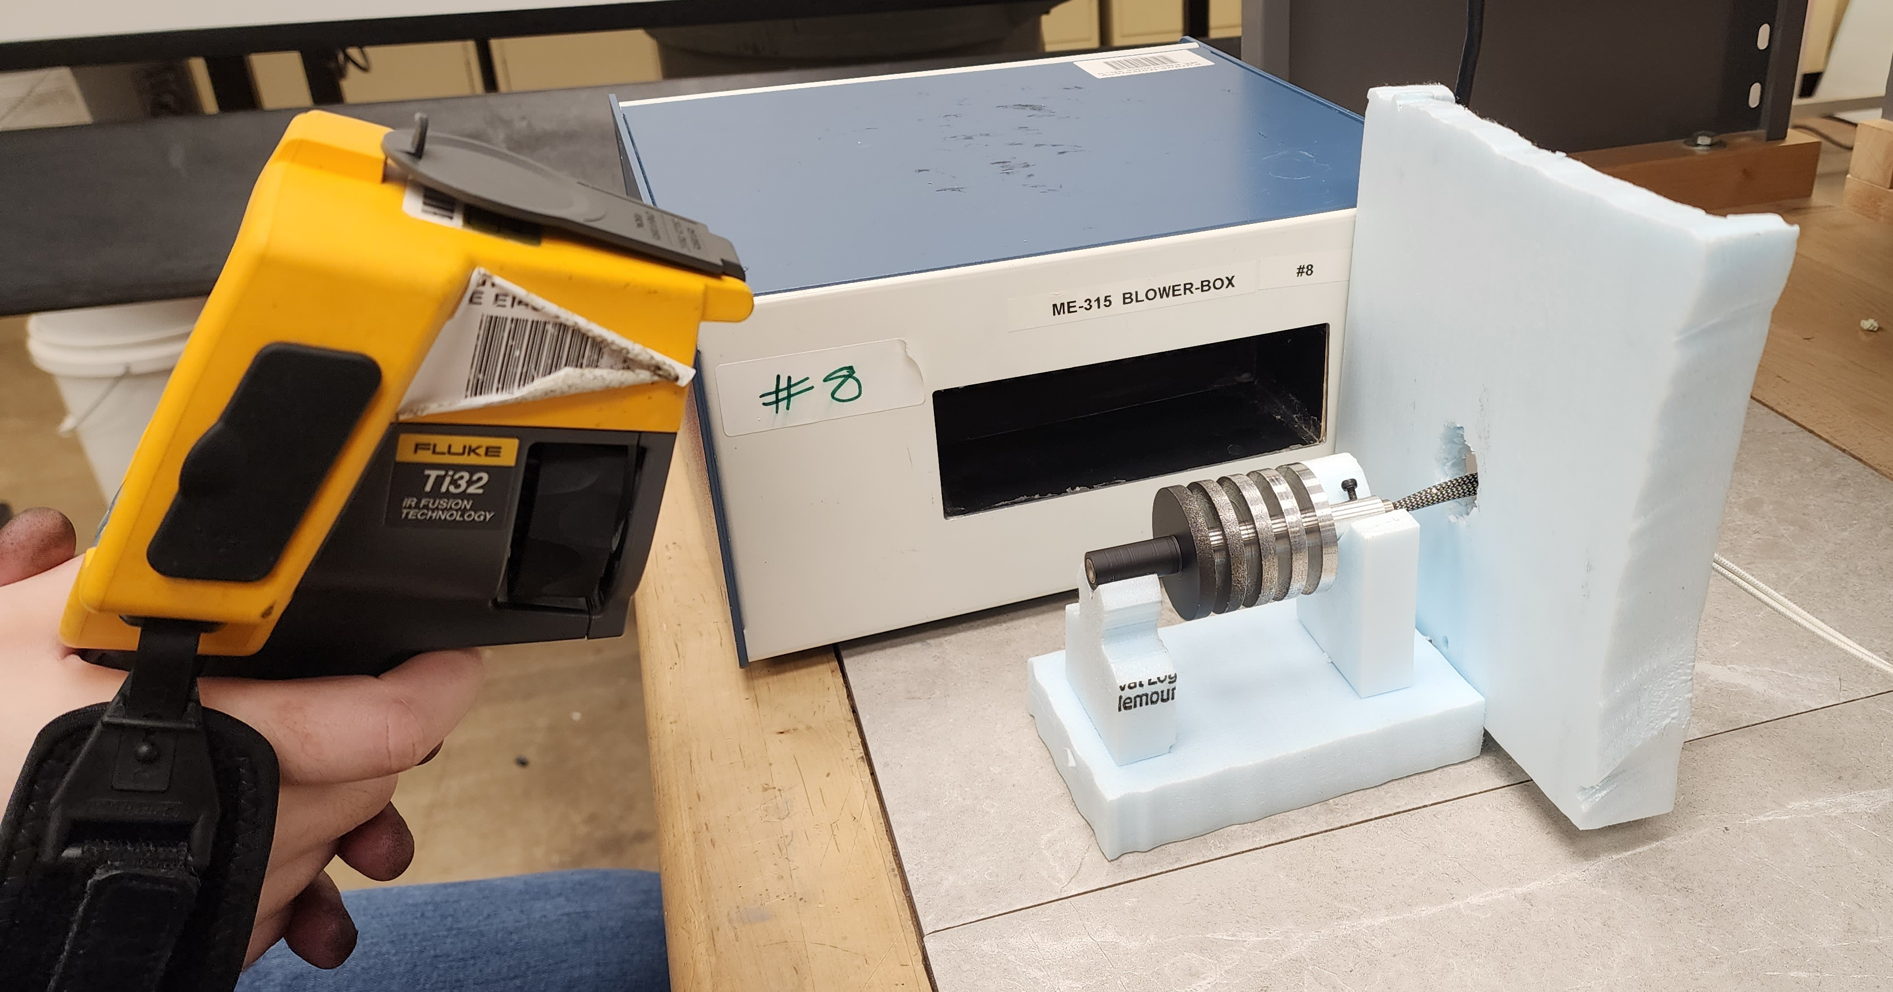
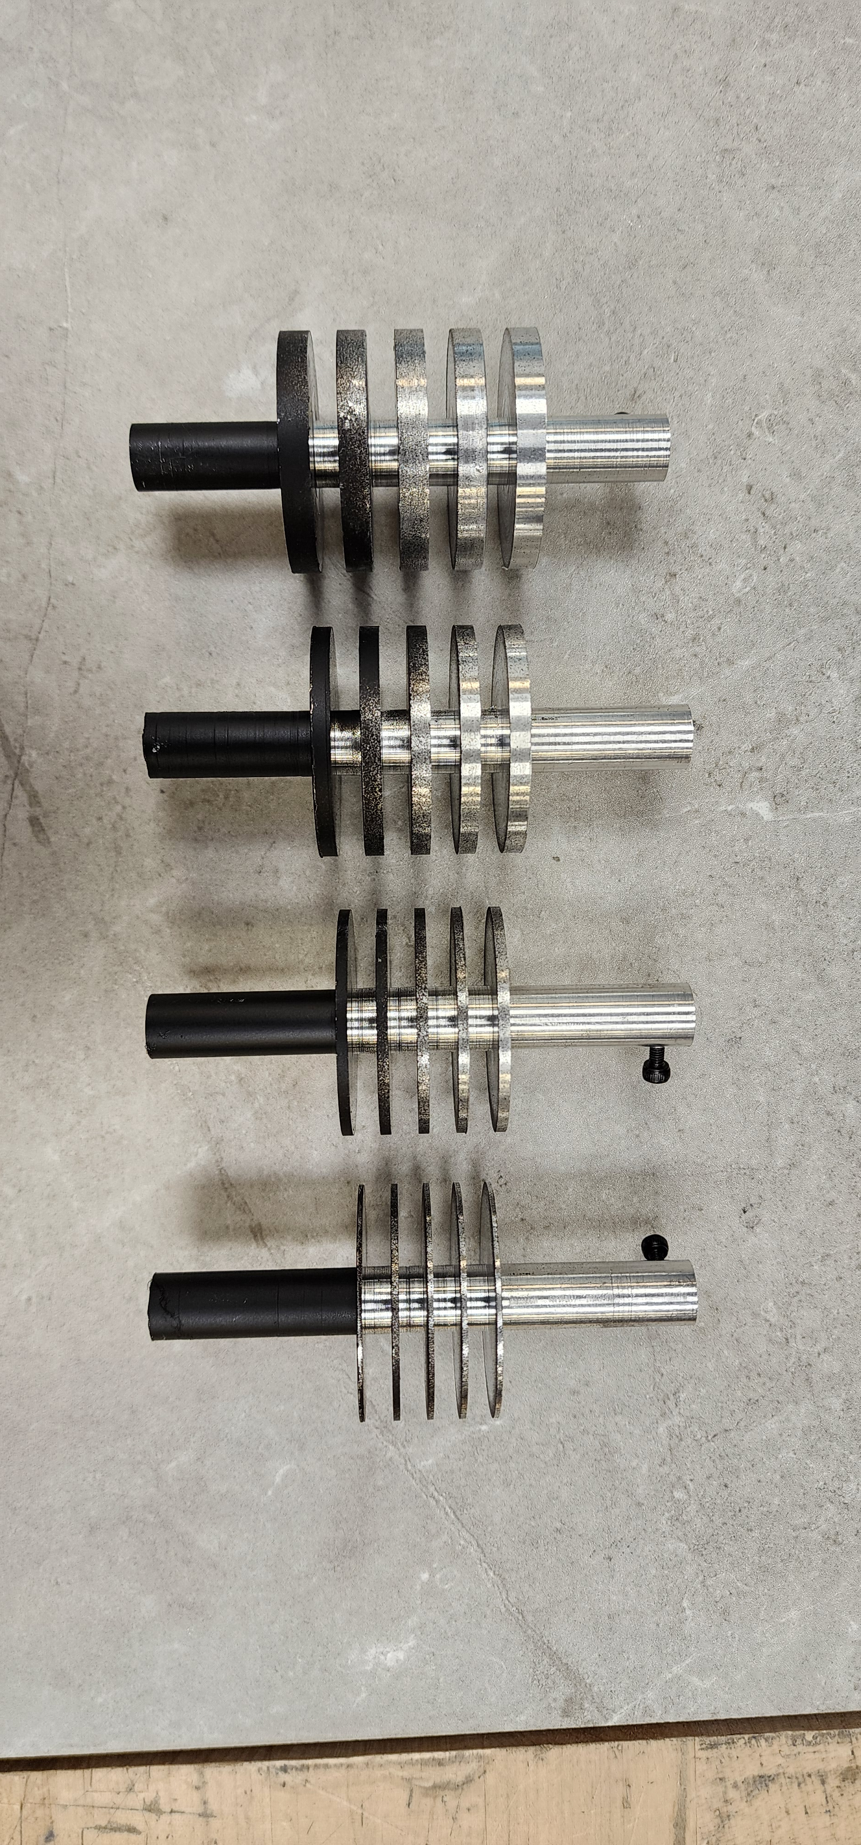
Experimental Procedure
Blower is set to a standard wind speed
Foam stand is held at a constant distance
Cartridge heats fin sleeve
Thermal imaging is taken at steady state
Steps are repeated for each fin model
Blower
Heating cartridge connected to the power stat
(not shown)
Thermal Camera
Fin Sleeve Model
Foam Stand

Slide 9
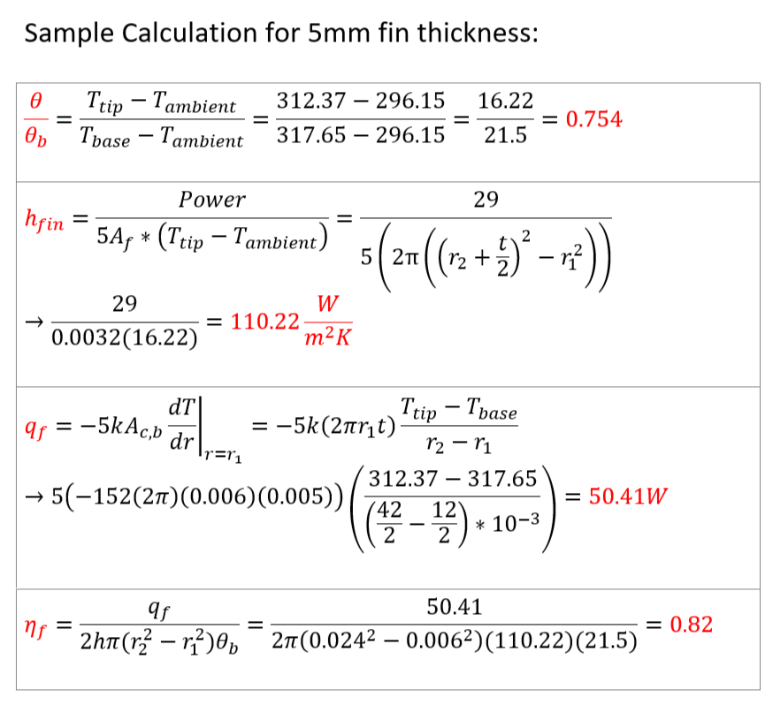
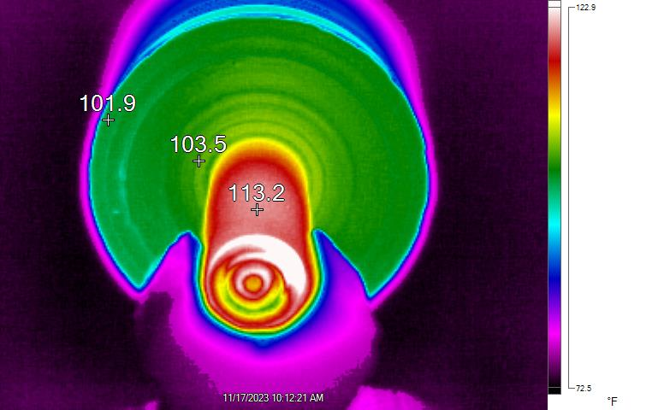
Experimental Data

Slide 10
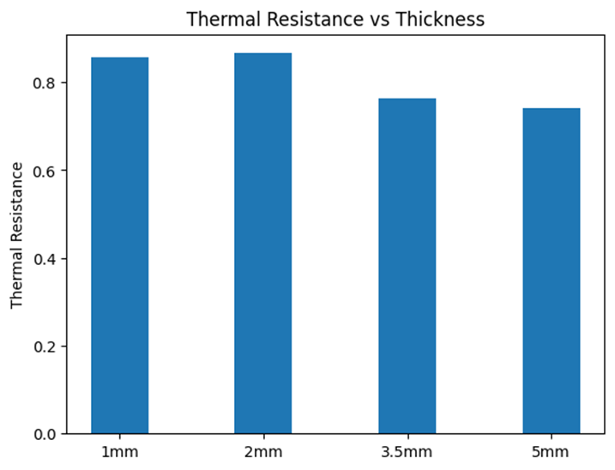
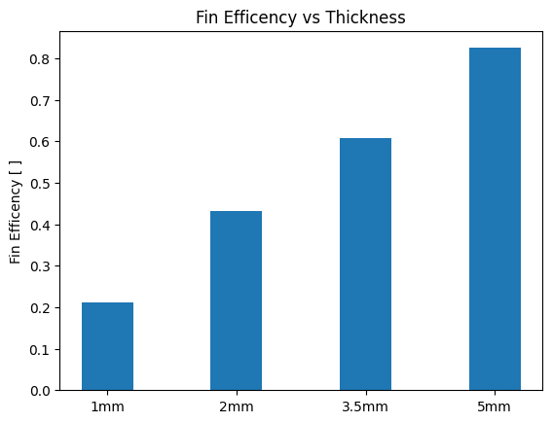
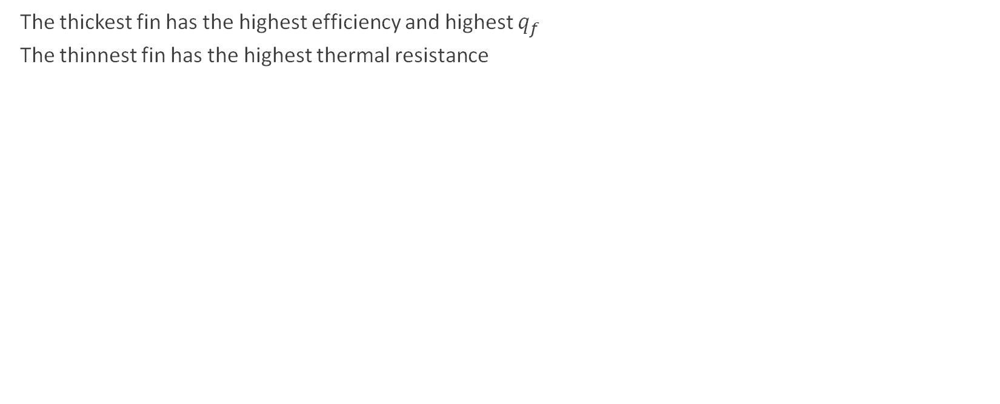
Results
The thickest fin has the highest efficiency and highest $q_{f}$
The thinnest fin has the highest thermal resistance

Slide 11
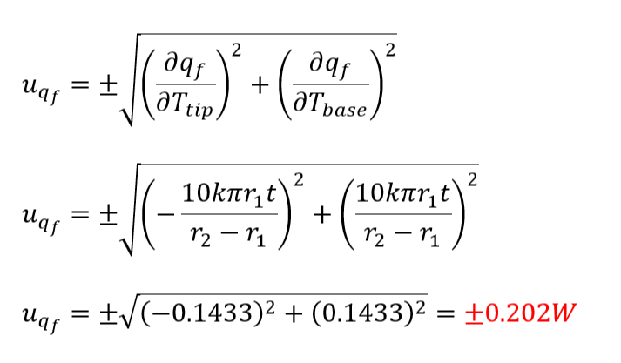
Heat Rate Uncertainty

Slide 12
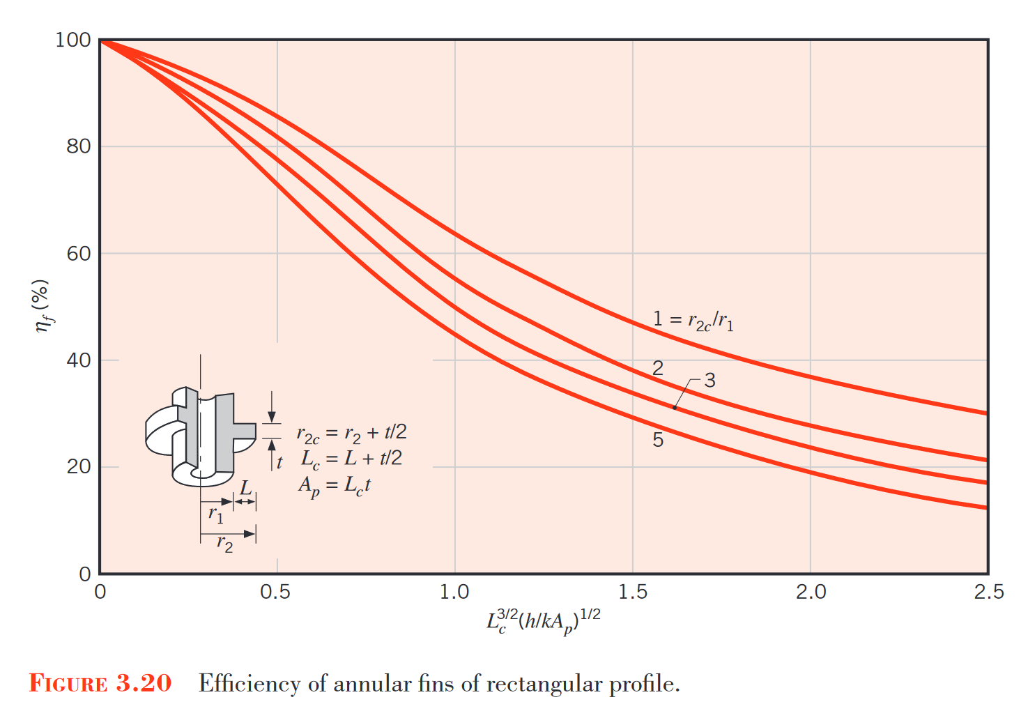
Empirical Validation
5 mm
3.5 mm
2 mm
1 mm

Slide 13
Limitations and Improvements
Did not use thermocouples
Pro: Would be difficult to attach to the fins and potentially impede airflow
Con: Limited data to be collected and reduced accuracy
Major assumptions and related improvements:
When steady state was reached – the experiment could’ve run longer to ensure accuracy
Negligible contact resistance due to transition fit – a more involved analytical approach could’ve been utilized
Not all power was transferred into the fins – insulate the exposed end of heating cartridge:
Electrical resistance
Stored energy
Radiation
Contact resistance

Slide 14
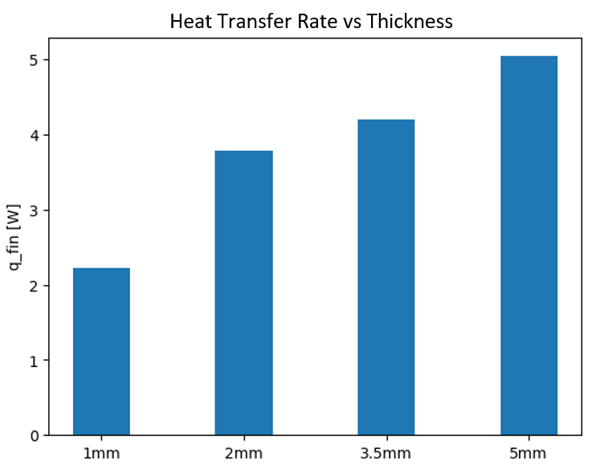
Takeaways
Data is well validated by empirical results
Annular fins are more complex to analyze
Non-uniform cross-sectional area
Efficiency of annular fins increases with thickness
Thicker fins allow for increased conductive heat transfer
A larger tip area also increases convection
Implications can extend into heat exchanger systems, PCs leveraging liquid cooling, residential/commercial HVAC, etc.

Slide 15
Thank you

Slide 16
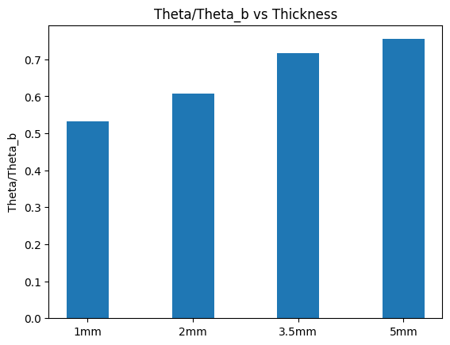
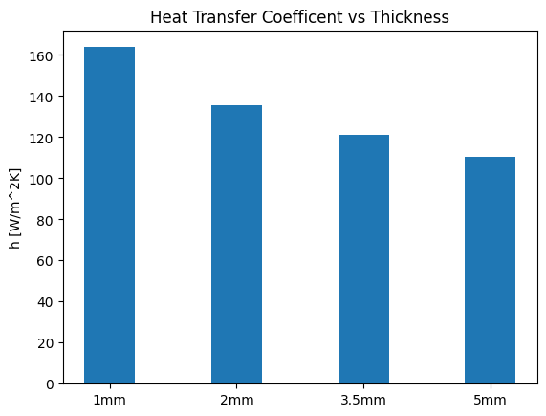

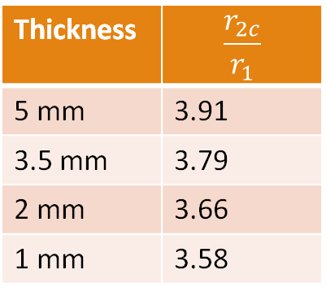
Thickness | $$\frac{r_{2c}}{r_{1}}$$
5 mm | 3.91
3.5 mm | 3.79
2 mm | 3.66
1 mm | 3.58

Slide 17
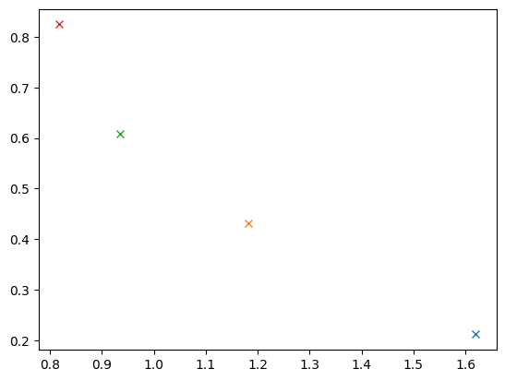
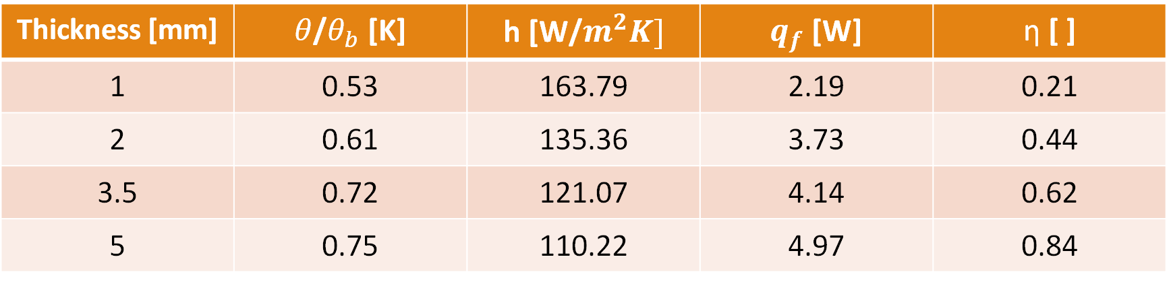
Thickness [mm] | $θ$/$θ_{b}$ [K] | h [W/$m^{2}K]$ | $q_{f}$ [W] | $\text{η}$ [ ]
1 | 0.53 | 163.79 | 2.19 | 0.21
2 | 0.61 | 135.36 | 3.73 | 0.44
3.5 | 0.72 | 121.07 | 4.14 | 0.62
5 | 0.75 | 110.22 | 4.97 | 0.84

Slide 18
